Slide 1
Integrated Platform Environment
By LWFS Team

Slide 2
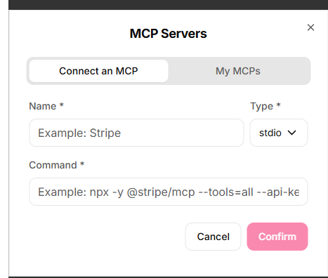
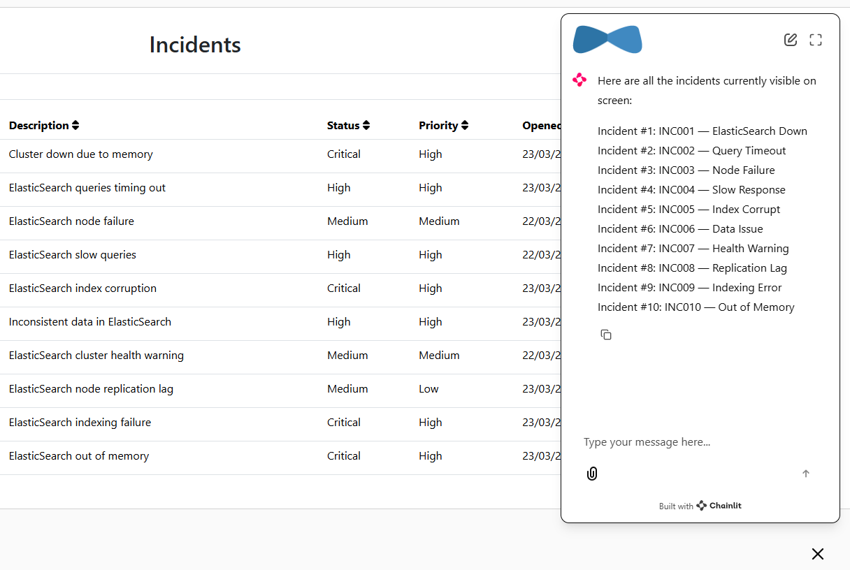
Key Features
How it works:
1
An MCP Based Personal Assistant (Demo Only) – General Purpose Skills (Confluence, Jira, Workday or Team Works etc
2
An Incident Management Screen with Smart Search (Demo Only) Alert: As a team we are still working to actually put it to work beyond Hackathon.
3
An Incident Assistant in Co Pilot mode With ability to grab context from the incident screen and ability to push back Alerts to screen.
4
Elastic Search is the CI supported today with an open source MCP Server (Fully Working). Service Now is also Integrated with the Incident Assistant

Slide 3


Agentic AI Principles
Platform Portal (React + Java)
Elastic MCP Server
1
Single Agent - Tool Use Design Pattern – Each Tool Being an MCP Client
+
2
Understands User Intent and makes Autonomous decisions to decide which tool to Invoke.
SNOW MCP Server
Assistant Technology
(Chain lit)
Lang-graph Agent
Open Architecture - Open for Extension to multiple Support Domains – with each domain Access Controlled (to be implemented)
.
.
.
3
OpenAI
GPT4
X MCP Server

